Slide 1



ANALYSIS OF CO2 EMISSIONS, POPULATION GROWTH, AND GDP IN NIGERIA.
An In-depth Study with Year-over-Year Growth Rates

Slide 2
INTRODUCTION
The purpose of this analysis is to understand trends , year over year growth analysis, correlation analysis, environmental impact and policy implications.
Aims &Objectives:
- To examine and understand the trends in CO2 emissions, population growth, and GDP in Nigeria.
- To analyze year-over-year growth rates.
- To examine the correlation between GDP and CO2 emissions.

Slide 3
DATA OVERVIEW
The dataset used in this analysis includes annual data for multiple countries, focusing on key variables such as population, GDP, and CO2 emissions (including land use change). The data spans several years, allowing for a comprehensive analysis of trends and correlations over time. For this project, the focus is specifically on Nigeria.
- Source:[https://ourworldindata.org/co2-and-greenhouse-gas-emissions]
- Variables: Population, GDP, CO2 Emissions (including land use change)
- Time Period: 1750 - 2023.

Slide 4
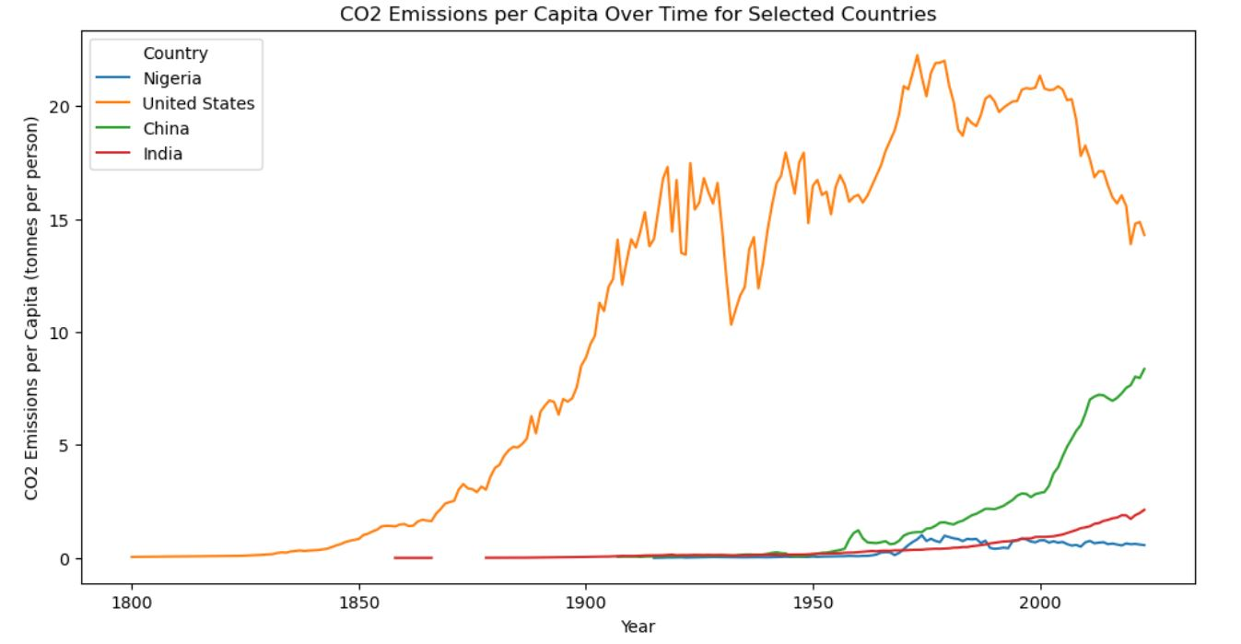
CO2 EMISSIONS PER CAPITA
This analysis focuses on the trends in CO2 emissions per capita for Nigeria compared to other countries, including the United States, China, and India.
• Nigeria has consistently low CO2 emissions per capita over the observed period.
• This reflects limited industrialization and a low reliance on fossil fuel-intensive energy sources.
• In contrast, the United States shows high emissions per capita, with a peak during the 20th century, while China displays rapid growth in emissions due to industrialization starting in the late 20th century.

Slide 5
CONTINUATION
• India, like Nigeria, maintains low emissions per capita but shows
gradual increases over time.
Implications:
• Nigeria’s emissions profile provides an opportunity to adopt a sustainable development path.
• Developed nations like the United States must lead global decarbonization efforts, while Nigeria and similar countries can leverage green technologies to avoid replicating high-emission growth patterns.

Slide 6
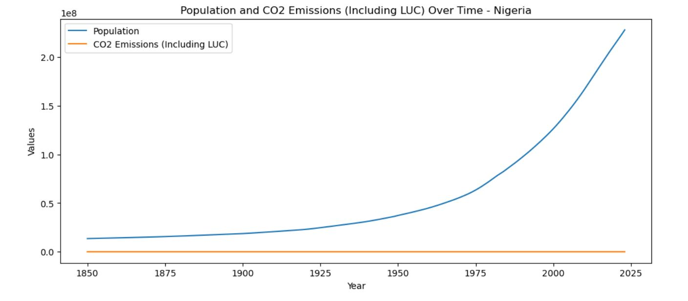
POPULATION AND CO2 EMISSIONS OVER TIME
The line chart compares Nigeria’s population growth and CO2 emissions (including LUC) over time.
• Key Findings:
• Population growth has been rapid, particularly after 1950, reflecting improved healthcare and economic conditions.
• In contrast, CO2 emissions remain flat and low throughout the timeline, even as the population increases significantly.
• This divergence highlights Nigeria’s low per capita emissions and limited industrialization.

Slide 7
CONTINUATION
Implications:
• Nigeria is in a favorable position to adopt sustainable energy policies before emissions begin to rise sharply due to urbanization and industrialization.
• Land Use Change (LUC) must be carefully monitored to prevent deforestation or unsustainable agricultural expansion from driving emissions.

Slide 8
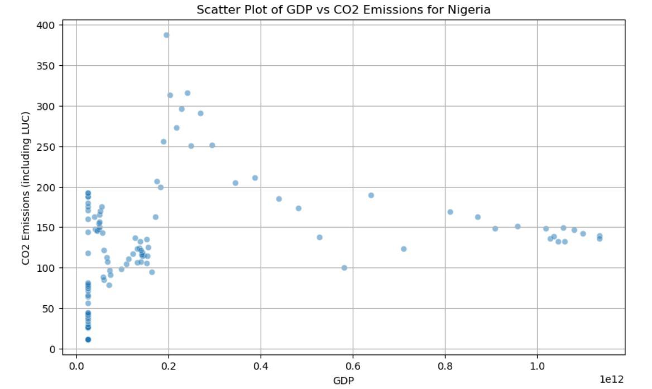
CORRELATION ANALYSIS
The scatter plot depicts the relationship between GDP and CO2 emissions (including Land Use Change - LUC) for Nigeria.
• There is no strong linear correlation between GDP and CO2 emissions.
• While GDP remains relatively low, CO2 emissions show a wide range, with notable outliers at higher emission levels despite modest economic output.

Slide 9
CONTINUATION
• This suggests that Nigeria’s economic activities are not predominantly emission-intensive.
Implications:
• Economic growth in Nigeria has been decoupled from high emissions, likely due to a reliance on low-emission sectors or practices.
• Policies can focus on maintaining this decoupling by promoting renewable energy and low-carbon industrial strategies.

Slide 10
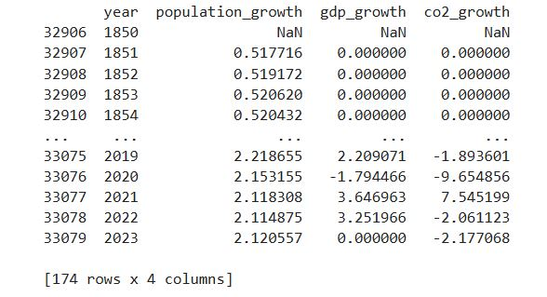
YEAR-OVER-YEAR GROWTH RATES
- Population Growth: The year-over-year growth rate for Nigeria's population was calculated. This provides insight into how the population has increased over time.
- GDP Growth: The GDP growth rate shows how the economic output of Nigeria has changed annually. It helps in understanding the economic health and performance of the country.
- CO2 Emissions Growth: This growth rate indicates the annual changes in CO2 emissions. A negative growth rate, such as -9%, signifies a reduction in emissions, which is a positive environmental outcome compared to a smaller reduction like -2%.

Slide 11
SUMMARY
1. Low CO2 Emission Economy:
Nigeria’s economic growth and population increase have not been accompanied by a proportional rise in CO2 emissions. This indicates a reliance on less emission-intensive activities and presents an opportunity to transition to green growth.
2. Opportunities for Sustainable Development:
By investing in renewable energy, sustainable urbanization, and green infrastructure, Nigeria can maintain its low-emission profile while meeting the demands of a growing population and economy.
3. Need for Data-Driven Policies:
Policymakers should focus on improving land-use practices and adopting low-carbon technologies in key sectors like energy, transportation, and agriculture.

Slide 12
CONCLUSION
The data reveals that Nigeria is positioned to build a sustainable economic future while maintaining its low-emission profile. Proactive policies in renewable energy, urban planning, and environmental management will be crucial in ensuring that economic growth aligns with global climate goals. By adopting a green development model, Nigeria can serve as a benchmark for other developing nations.

Slide 13
RECOMMENDATIONS
1. Sustainable Energy Transition:
Accelerate investments in renewable energy to meet future energy demands sustainably.
2. Monitor Land Use:
Ensure deforestation and agricultural activities are managed to prevent unnecessary emissions from Land Use Change.
3. Encourage Green Industrialization:
Promote low-carbon industries to boost GDP while keeping emissions under control.
4. Sector-Specific Analysis:
Conduct detailed assessments of sectoral emissions (e.g., energy, transportation, agriculture) to identify key areas for intervention.

